Slide 1
The Mid-Hants Railway’s
Model Railway in a railway van
by
Rob Score 2014
Updated by Dave Harris 2020

Slide 2
The Team: Summer 2010
The MHR wagon group: over 10 years experience in restoring wagons & one of the largest historical freight fleets in UK
The Basingstoke & N Hants Model Railway Society: over 20 years experience of building model railways
So putting a model railway in a railway van should be easy – yes ?

Slide 3
The model’s Specification
A section of single track, a station and turnback loop at each end
A country setting like the MHR
To demonstrate single line operation to our visitors
To have appropriate sound effects
To have 2 modes of operation: fully automatic or driven by the public
Interactive
The aim: to offer a different experience to visitors and encourage purchase of models from the shop.

Slide 4
Interactive Model Railway Timeline
August 2010: concept agreed
December 2010: Outline design complete
August 2011: Carpentry work/baseboards complete
March 2012: Completion of model by Basingstoke & N Hants MRS (at Basingstoke)
Sept 2012: first public showing @ Medstead Yard (automatic working only, not 100% reliable)
Sept 2012: Hardwood surround & glazing installed
Oct 2012: Installed infra red detectors #2
Jan 2013: commissioned public control panel
March 2013: Interactive railway launched at Spring Gala

Slide 5
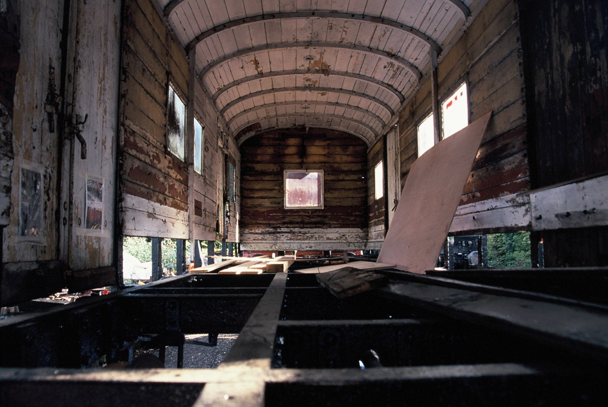
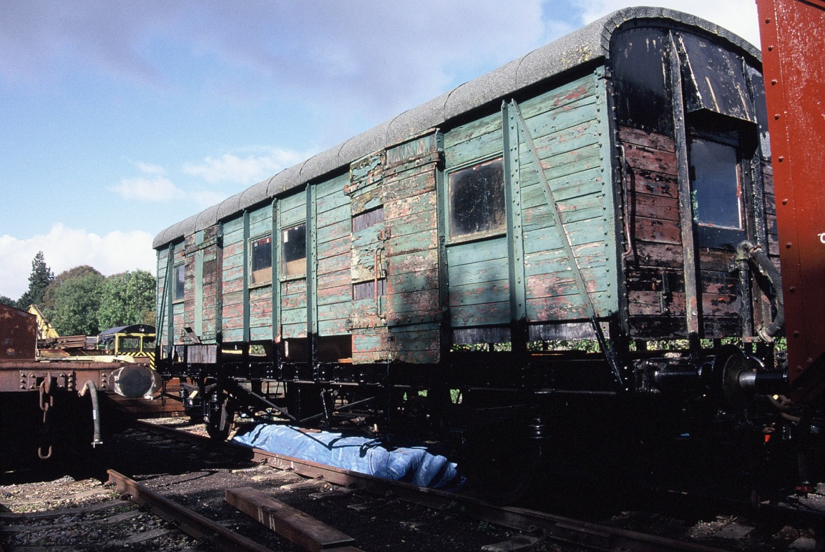
Challenge No.1: Find a Railway Van
SE&CR Parcels and Miscellaneous Van (PMV)
2009

Slide 6
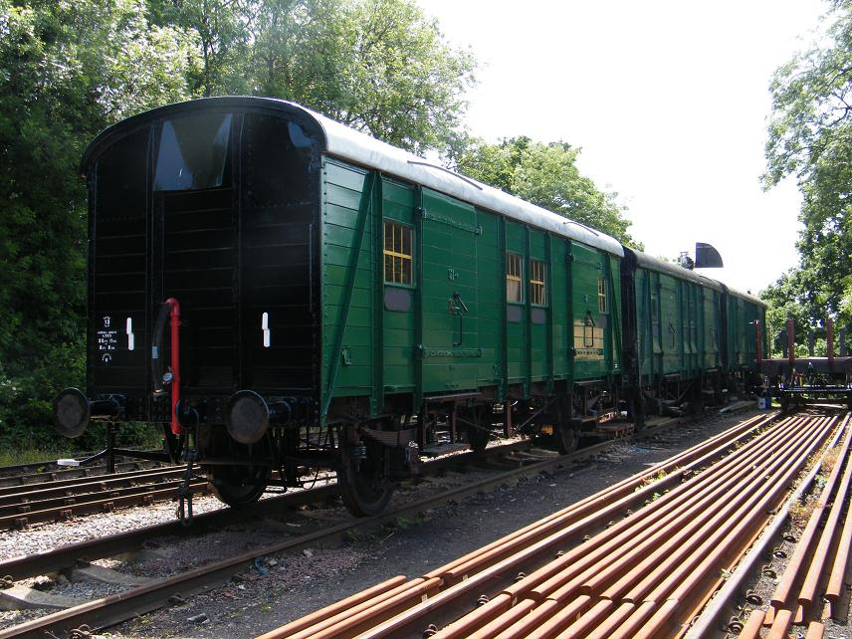
SE&CR PMV S1995S
June
2011

Slide 7
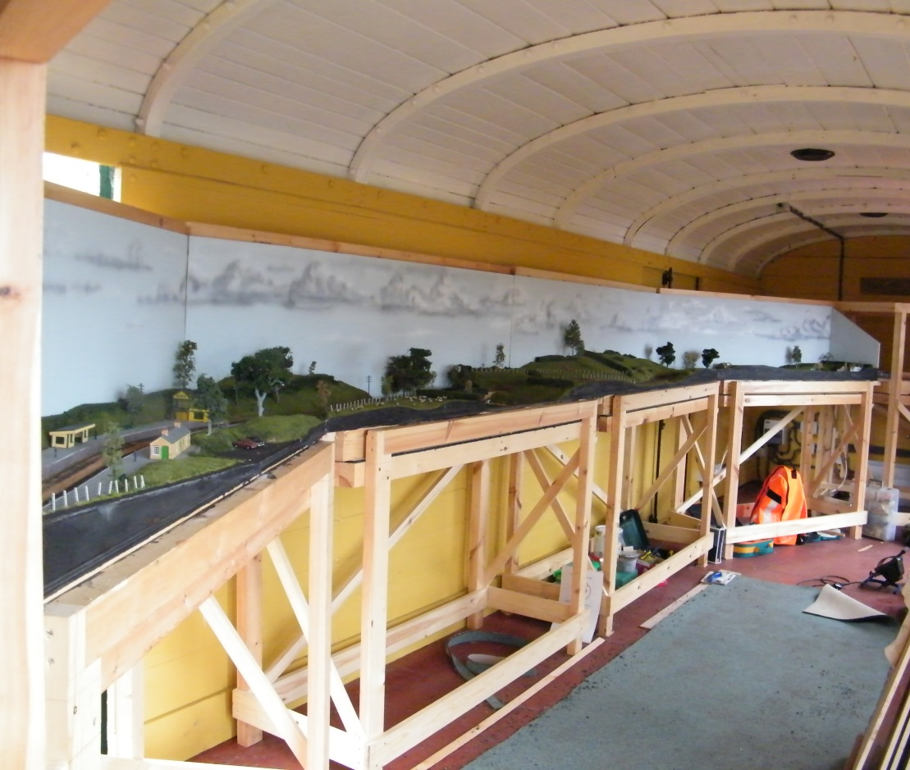
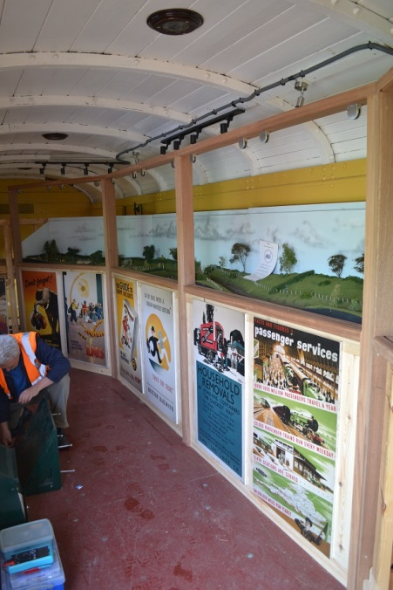
Challenge No.2: The ex-NRM boards
Help up carpentry work by 5 months
Awaiting EBAY bid + collection from York

Slide 8
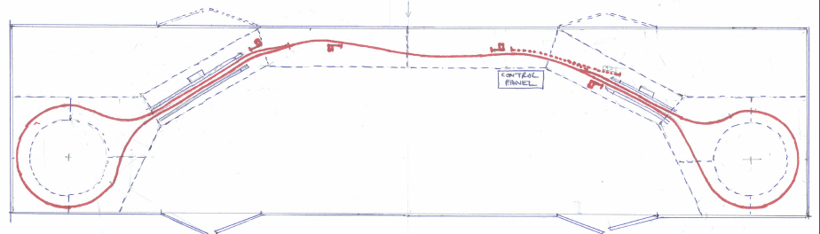
Challenge No.3: Baseboards & Support Structure
Baseboard plan:
Good length of running line
Track crossed joins at roughly 90⁰ (lots of angles in woodwork)
MHR carpenters did a first rate job

Slide 9
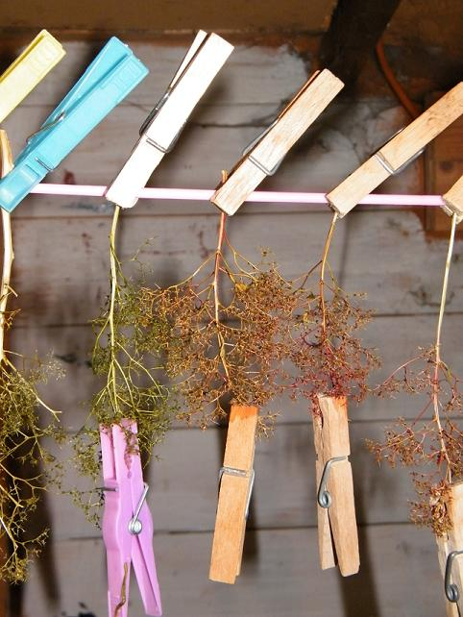
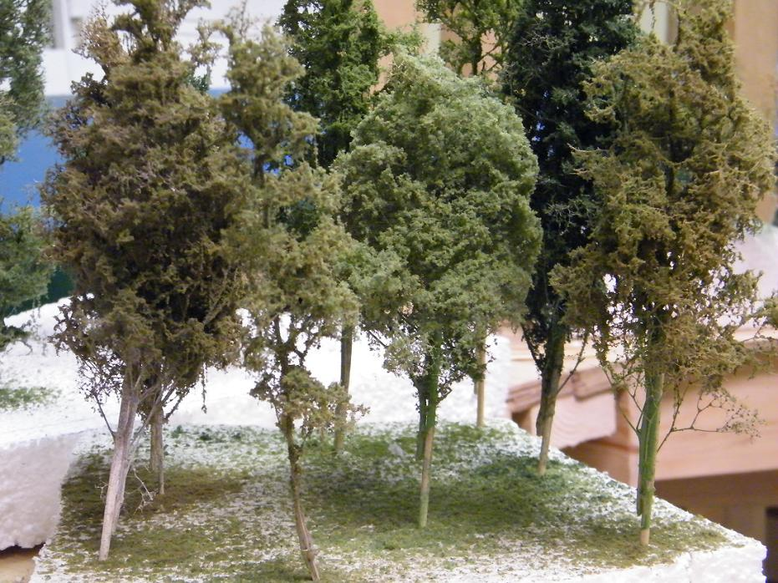
Challenge No.4: Modelling & Scenics
Getting the modelling team right (size, expertise)
Modelling the trees (limited expertise)
Two types: Sea Moss and Hebe

Slide 10
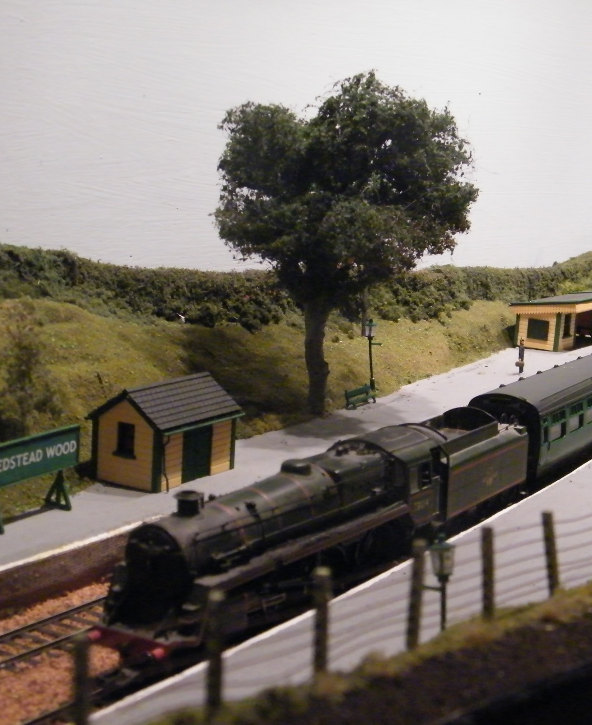
Hebe Trees
Dried hebe plant
for basic tree shape
Add wire wool
& green flock

Slide 11
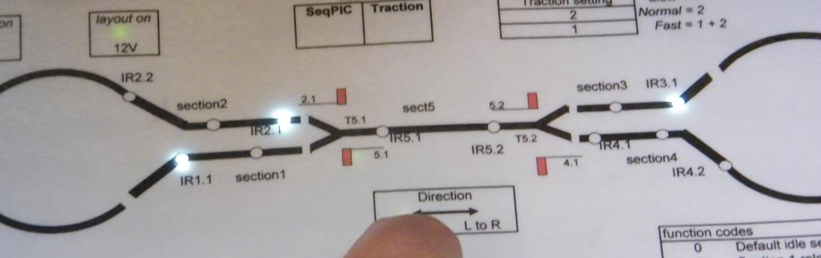
Challenge No.5: The Electronics
Eleven microprocessors:
1 for traction speed (pulse width modulation)
1 for controlling points, signals, & switching traction power on and off
1 for public control panel (the interactive bit)
8 Infra-Red detectors
The biggest issue: the Infra-Reds ……

Slide 12
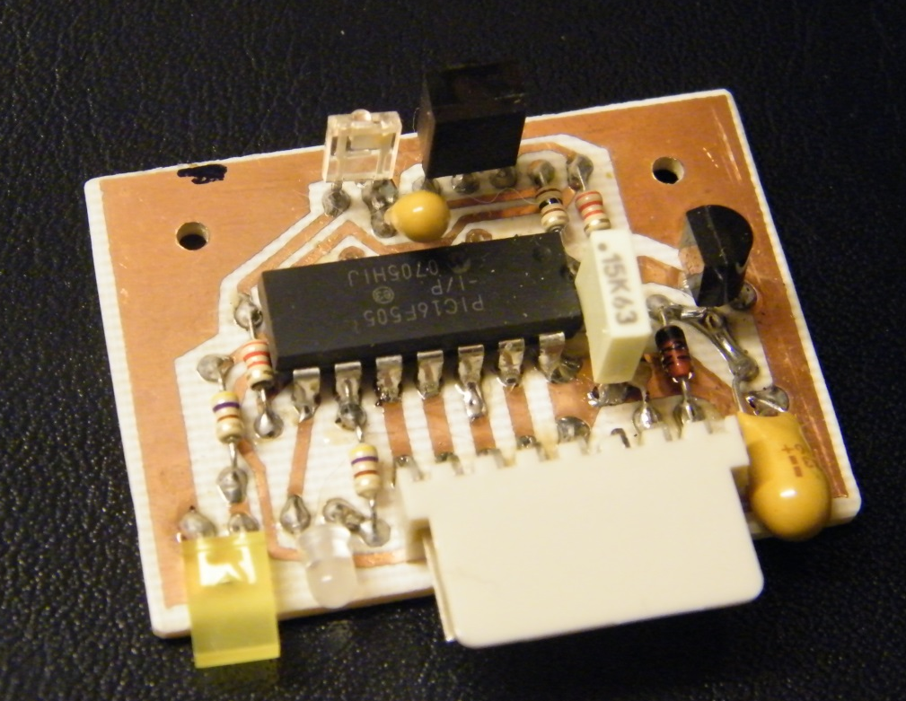
Infra-Red Detectors: How they work
IR Detector placed in model ‘four-foot’
Emitter emits flashing IR
IR light ‘bounces’ off underside of model loco
Sensor picks up ‘flashing’ pattern
Issues:
Consistent detection of locos
False readings (nothing there)

Slide 13
Consistent detection of Locos
Underside of model locos matt black
First solution: strip of reflective plastic tape
Hornby locos overshot – 4.5 inch strip
Bachmann better: 3.5 inch strip
Weeks of trial running with red tape: not good enough
White plastic card strip + blu-tac proved the best

Slide 14
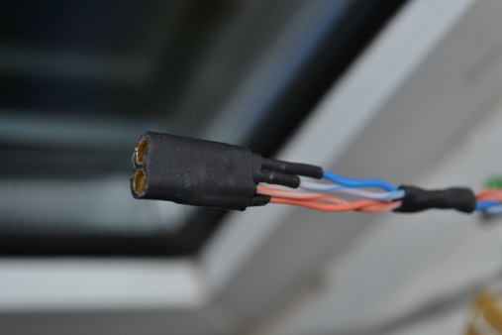
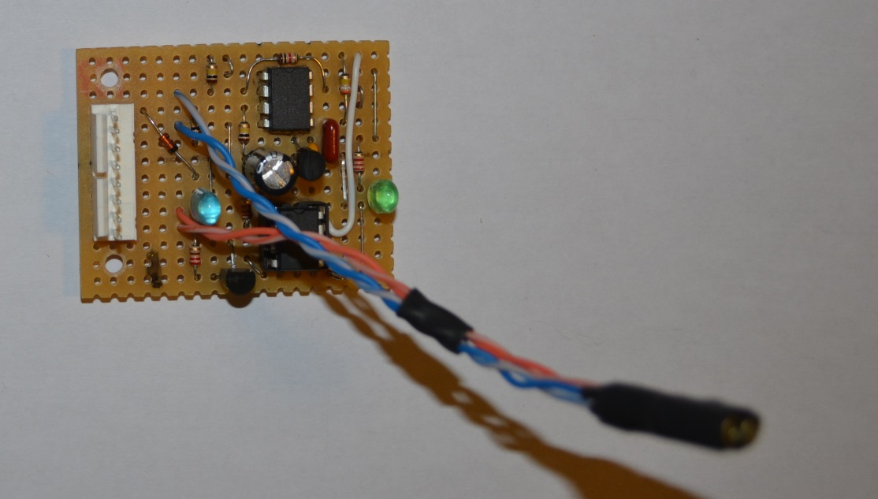
False Readings (nothing there)
Consistent detection of locos highlighted false readings issue
Consulted MERG: component sensitive to radio/electronic interference
Mark I version scrapped, replaced with mark II

Slide 15
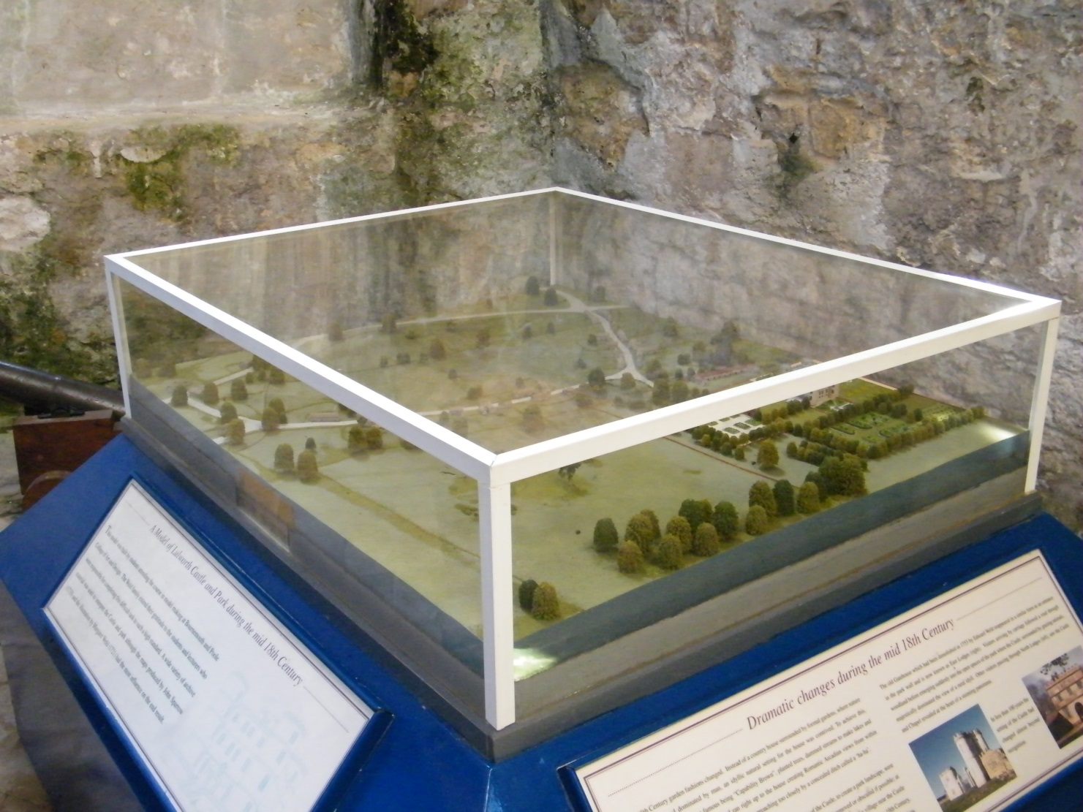
Challenge No.6: The Glazing
Original concept: glazing cabinet

Slide 16
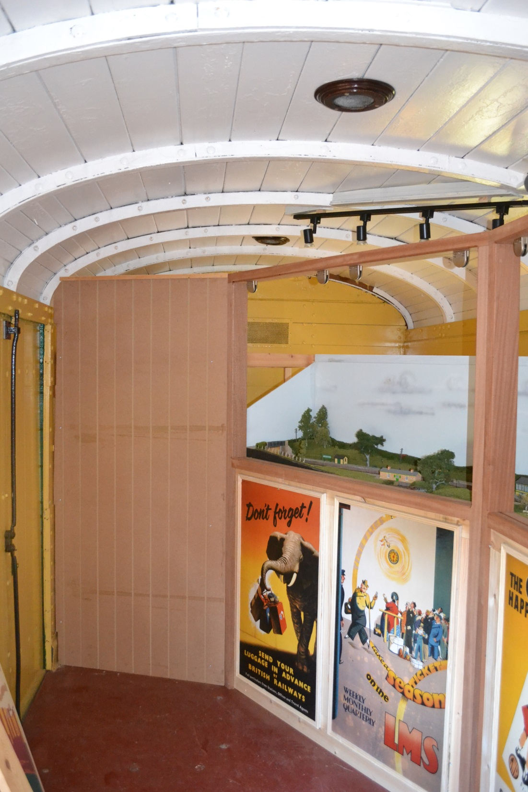
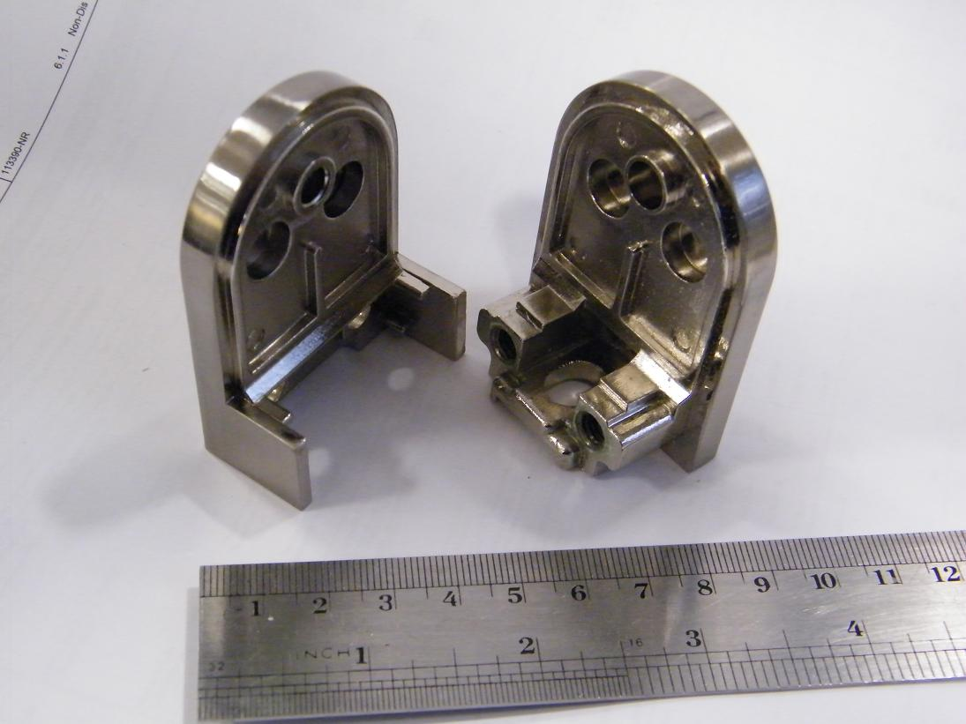
Glazing: the solution
(with thanks to John Larke)

Slide 17
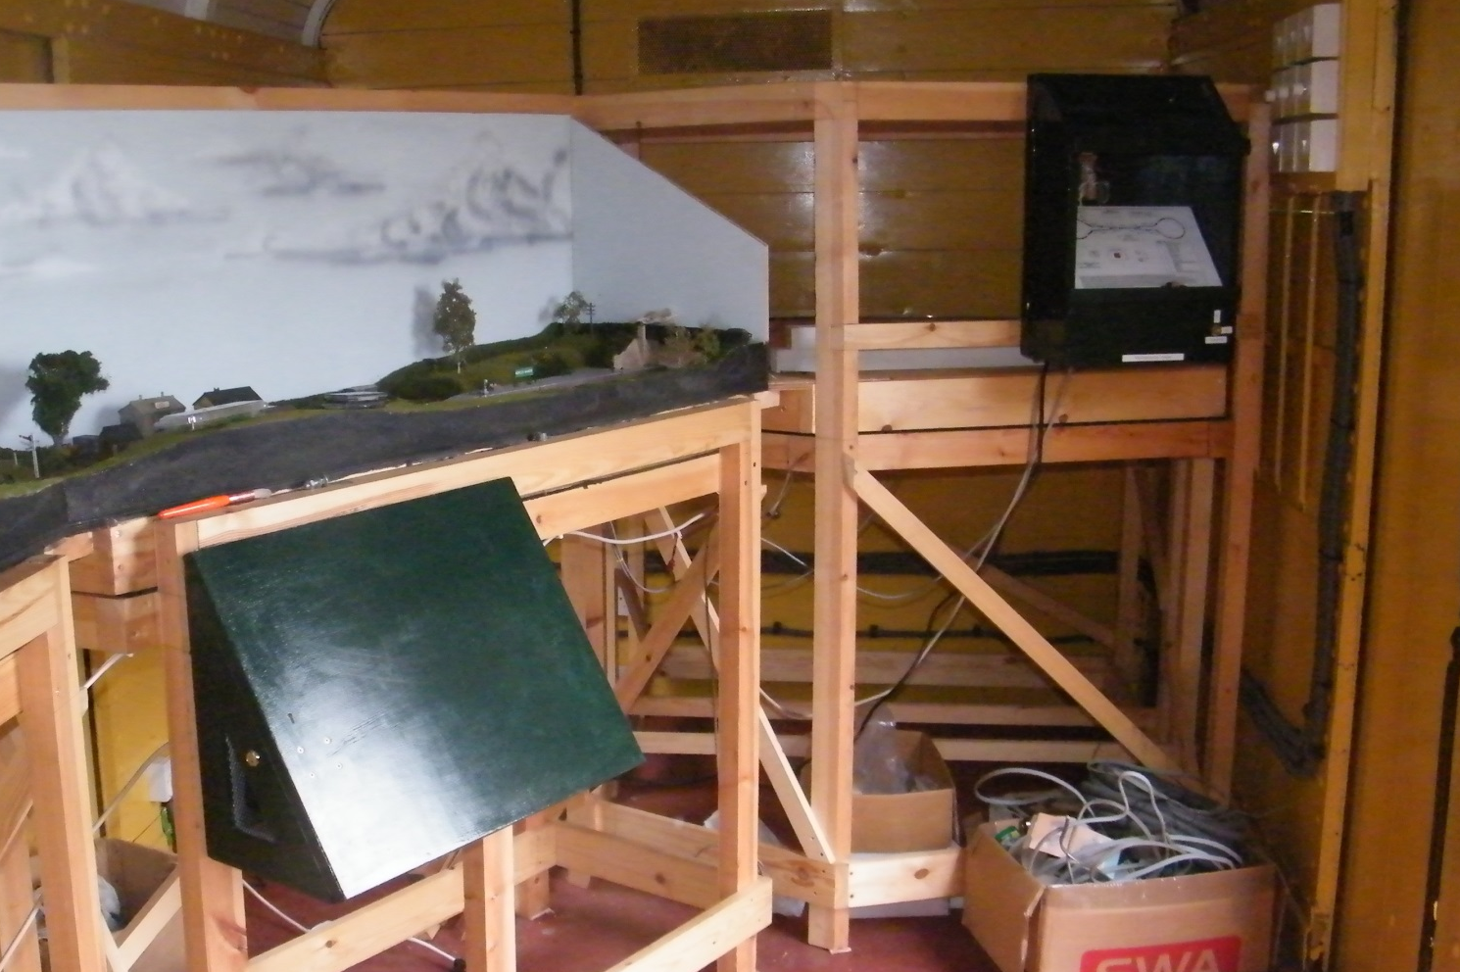
Challenge No.7: Interactive Control
The computer must control the trains
The public press buttons to simulate operations
Bespoke hardware and software (basic form of ‘C’ code)
Maintenance panel controls the trains & signals
Public Panel expects buttons to be pressed in the right order
The two panels ‘talk’ to each other

Slide 18
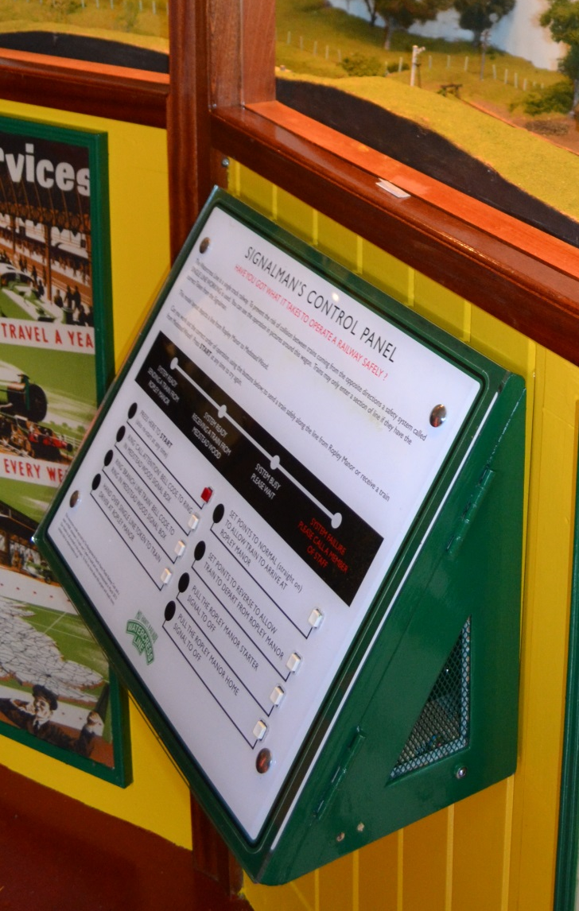
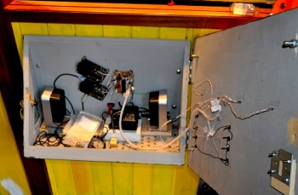
Public Control Panel
Smart fascia with robust buttons
Inside – speakers for sound effects

Slide 19
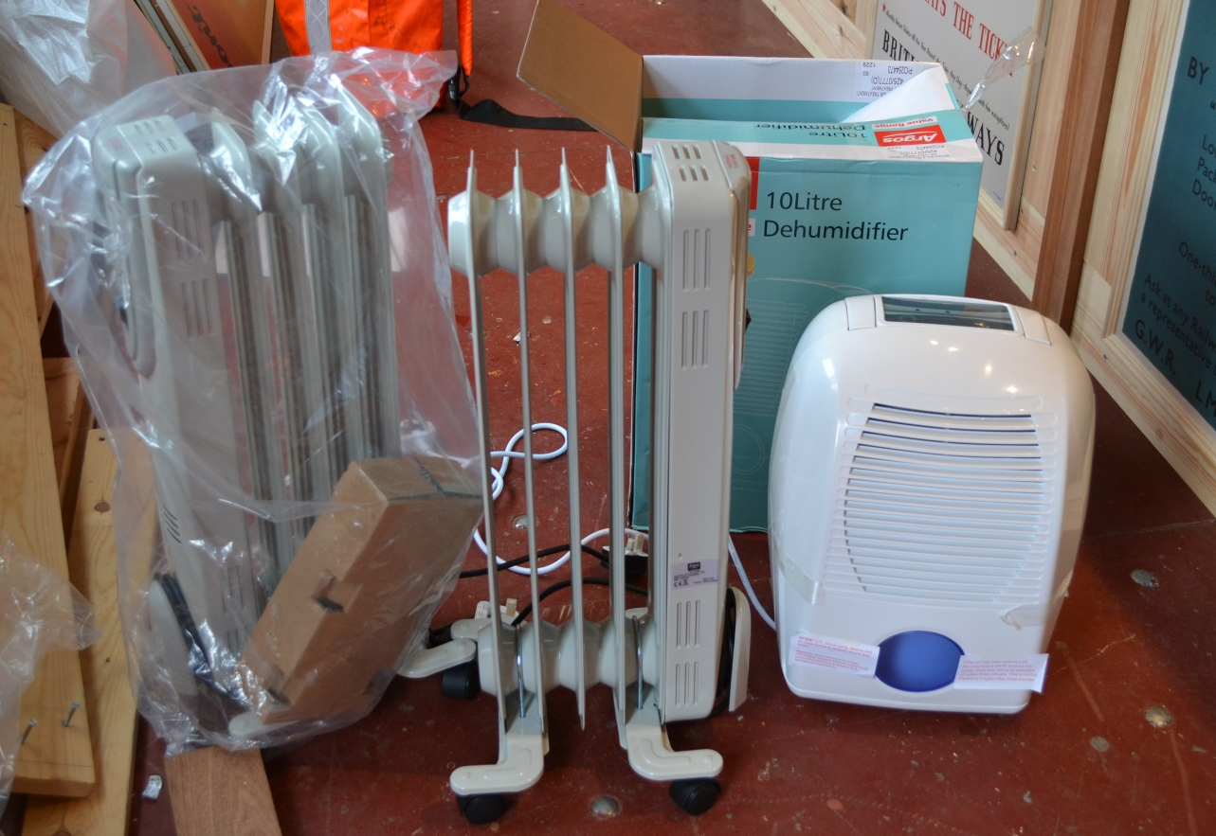
Challenge No.8:
An operational railway vehicle
It can move about!
Accident damage when shunting (only once!)
Loss of ‘ship to shore’ supply (cable burnt)
Cold and Damp:

Slide 20
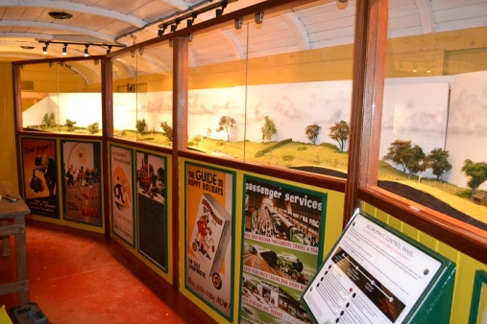
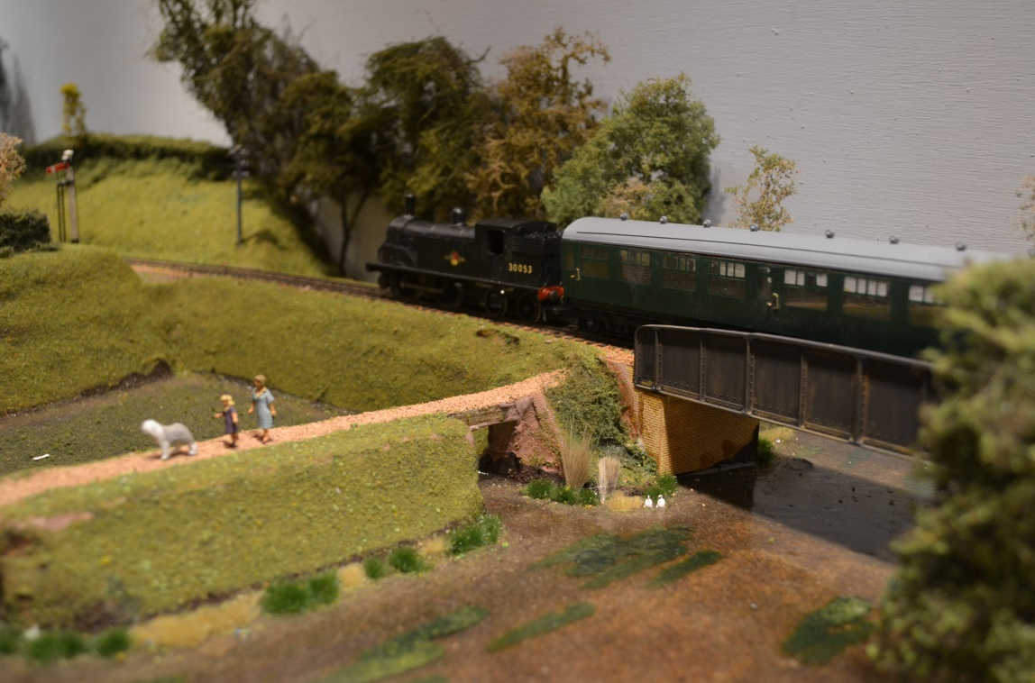
Challenge No.9:
Showing the Model Railway
Spring & Autumn Galas, Thomas week. Wizard week in 2014
Manning issues

Slide 21
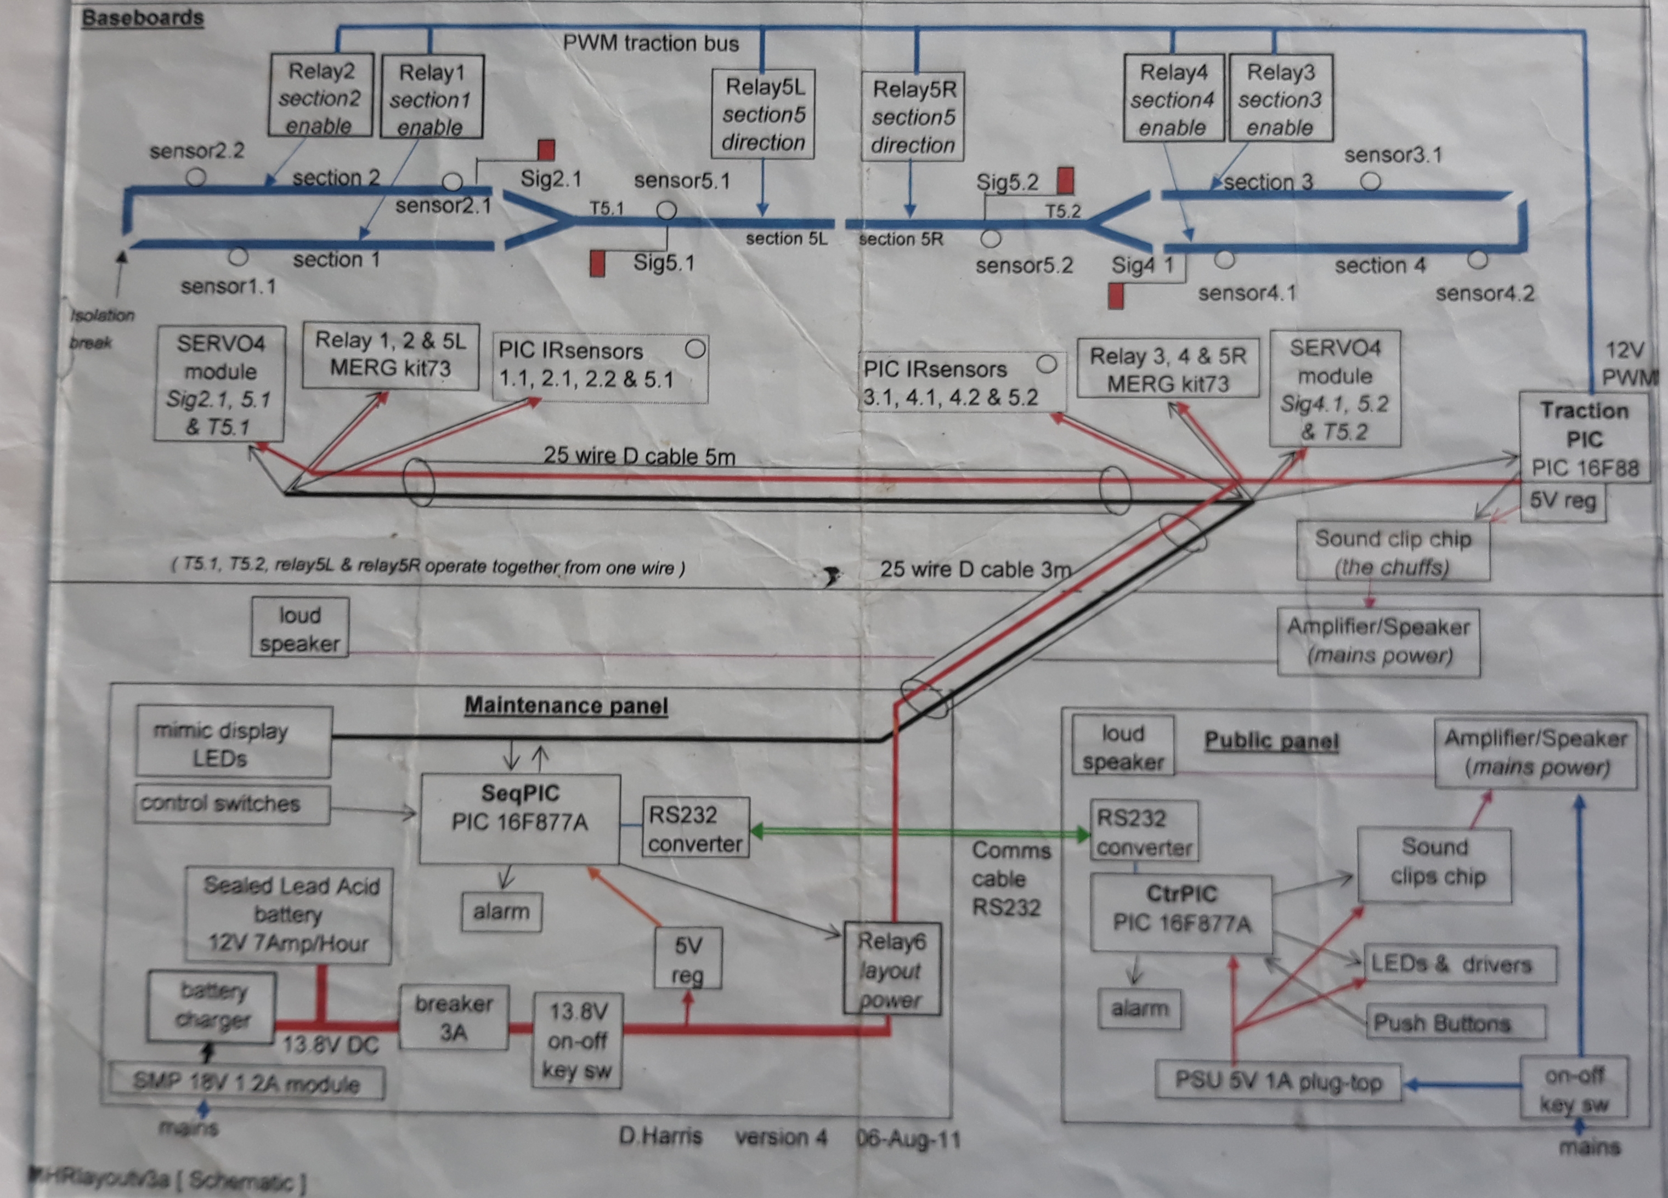
Schematic

Slide 22
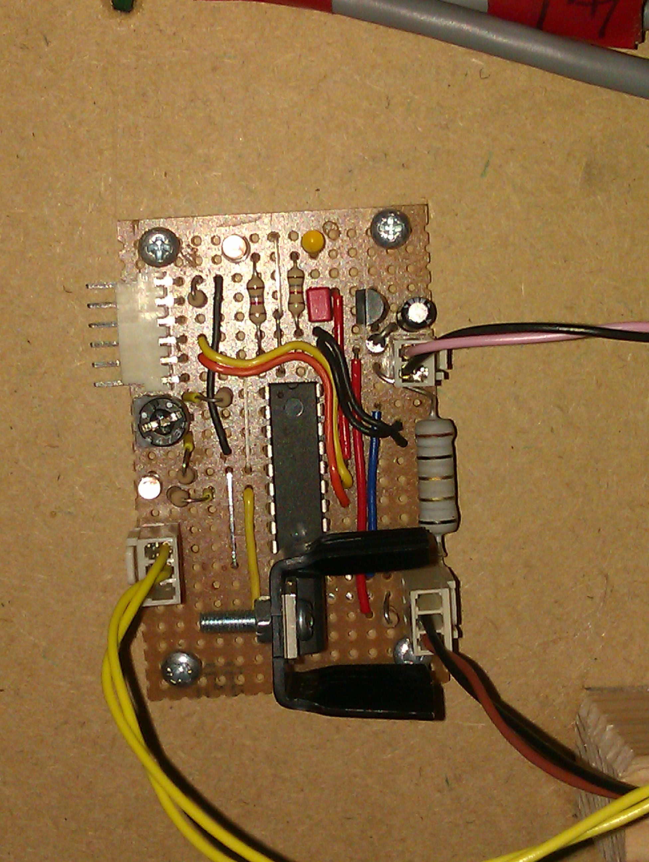
Traction PIC

Slide 23
The MHR Interactive Model Railway
Any Questions
?

